Slide 1
HTML 2

Slide 2
Element Categorization
Elements are categorized as inline or block-level based on their default display behavior and how they interact with other elements on a webpage.

Slide 3
Block-level Elements
A block-level element always takes up the full width available (stretches out to the left and right as far as it can).
Occupy 100% of the parent’s width (unless styled).
Stack vertically, pushing subsequent content to a new line.
Can contain both inline and other block-level elements.
Support width, height, margin, and padding properties fully.

Slide 4
Examples
div , p , h1–h6 , header , footer , section , article , nav , aside , main , form , ul , ol, li , table , hr , pre , table , caption , thead , tbody , tfoot , tr , th , td , fieldset , legend

Slide 5
Inline Elements
Elements that flow within the content, taking only the width needed for their content and not starting on a new line.
Do not break the flow of content (no new line).
Typically cannot have width, height, or top/bottom margins (unless styled as block or inline-block)
Can contain other inline elements but not block-level elements (in valid HTML).

Slide 6
Examples
a , span , i , b , strong , u , sub , sup , small , mark , del

Slide 7
Inline Block Elements
Inline-block elements are HTML elements whose display behavior combines characteristics of both inline and block-level elements.
They flow inline with surrounding content, but unlike pure inline elements, they allow block-level formatting, meaning you can set properties such as width, height, margin, and padding on all sides.
This makes inline-block elements especially useful for creating flexible layouts, aligning multiple boxes horizontally, and styling inline components without forcing them to occupy the entire width of their parent container.

Slide 8
Examples
<img>, <button>, <input>, <select>, <textarea>, <label>

Slide 9
DIV
The div tag is known as the Division tag. The HTML <div> tag is a block-level element used for grouping and structuring content. It provides a container to organize and style sections of a webpage, facilitating layout design and CSS styling.

Slide 10
SPAN
An inline-level element used to style or group smaller portions of content, like text or a few elements, without breaking the flow of the line.
NOTE:the <div> and <span> tags are used for structuring and styling content. <div> creates block-level containers for grouping elements, while <span> creates inline containers for styling specific portions of text or elements within a block-level container.

Slide 11
DIV AND SPAN
Feature | <div> | <span>
Type | Block-level | Inline-level
Default Display | Full width, new line | Fits content, same line
Use Case | Group larger sections/layouts | Style or group small text/portions
Typical Content | Multiple elements (e.g., paragraphs, images) | Text or small inline elements

Slide 12
Semantic Tags
HTML introduced a range of semantic elements that clearly describe their purpose in human and machine-readable language. Semantic tags clearly define their content.
Examples: <article>, <aside>, <details>,<summary>, <figcaption>, <figure>, <footer>, <header>, <main>, <mark>, <nav>, <section>

Slide 13
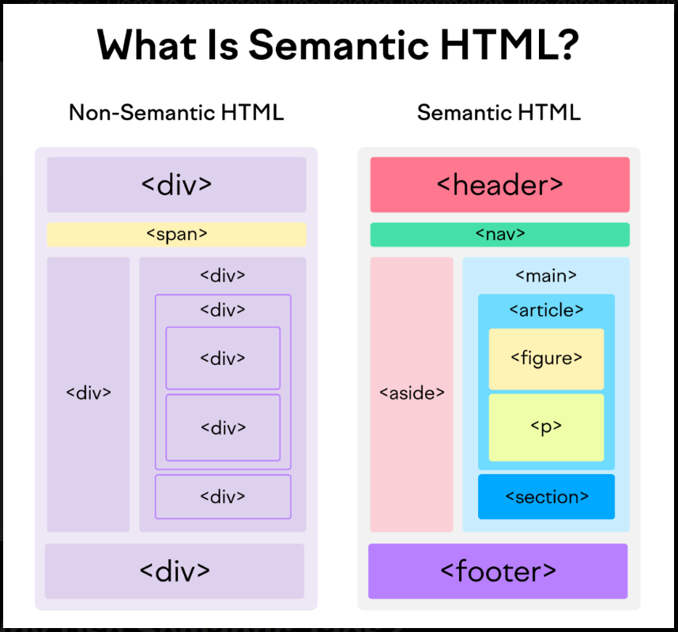

Slide 14
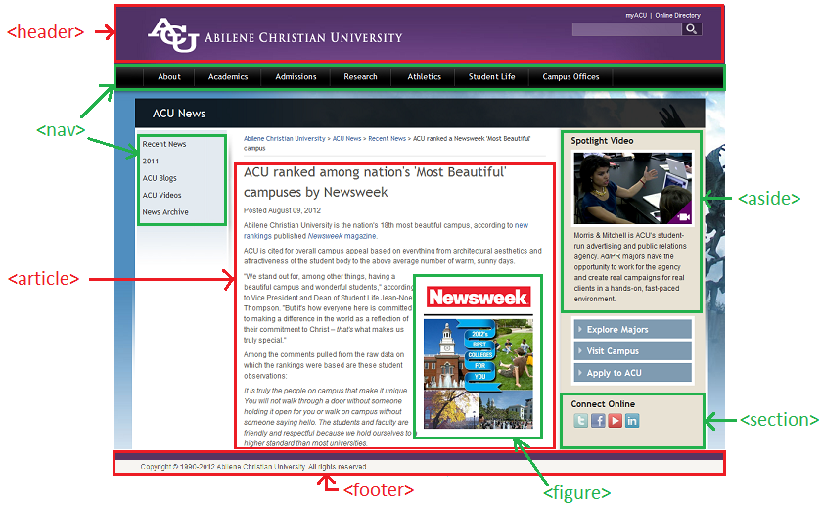

Slide 15
Why use Semantic Tags
Accessibility: Semantic elements make web pages more accessible. Screen readers and developers can interpret the structure and navigate the content more efficiently.
SEO: Better structured data leads to better SEO. Search engines prioritize well-structured content that uses semantic elements correctly, as it’s easier to index.
Maintainability: Semantic HTML helps create a logically structured document, which is easier to read and maintain.

Slide 16
<header> tag
The <header> tag is a semantic HTML element that is used to define the introductory or navigational content of a webpage or a section. Typically, a header contains elements like:
The website or page title
Logo or branding
Navigation menus
Search bar
Any introductory information relevant to the page or section

Slide 17
<nav> tag
The <nav> tag in HTML is used to define navigation sections on a webpage. It typically contains links to key parts of the site, such as the main menu, table of contents, or index. These links are usually organized using unordered lists (<ul>) or displayed as standalone links.
Using the <nav> tag improves the semantic structure of a webpage, helping both users and search engines understand which parts of the page are meant for navigation.

Slide 18
<footer> tag
The <footer> tag in HTML is used to define the footer section of an HTML document.
The footer section typically contains information such as contact information, sitemap, back-to-top links, related documents, copyright, etc.
The footer tag is a semantic tag included in HTML along with other tags like article, nav, header, etc.
It is not mandatory, but adds to clear structure to the document and useful for SEO.

Slide 19
<main> tag
The HTML <main> Tag defines a document's main content, which should be unique. It excludes content like sidebars, navigation, logos, and copyright info, ensuring unique document-specific material within.
Note: The document must not contain more than one <main> element. The <main> element should not be a child element of an <article>, <aside>, <footer>, <header>, or <nav> element.

Slide 20
<article> tag
The HTML <article> tag defines a self-contained, independent piece of content like a blog post, news article, or comment. It is designed for content that can be independently distributed, shared, providing semantic meaning to the content.
This tag is most often used in two contexts:
On a page with a single piece of content, a single <article> element can be used to contain the main content and set it off from the rest of the page.
On a page with multiple pieces of content, multiple <article> elements can be used to contain each individual piece of content.

Slide 21
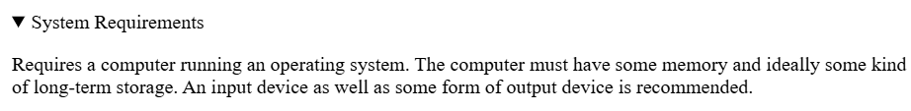
<details> tag
The <details> tag in HTML is used to create a disclosure widget from which the user can view or hide additional information. It is used with the <summary> tag, which provides the title or header for the details section. It's generally used for FAQs, dropdown menus, or to show/hide additional content.

Slide 22

<details> tag Attributes
open: The detail tag has an attribute called open which is used to display the hidden information by default.
name : This attribute enables multiple <details> elements to be connected, with only one open at a time. This allows developers to easily create UI features such as accordions without scripting.

Slide 23
<figure> tag
The <figure> tag is used to insert self-contained content such as illustrations, diagrams, photos, or code listings in a document. It can be placed at any position in the document and is related to the main flow. The content inside the <figure> tag goes with the flow of the document, so if it is removed, it won't affect the flow of the document. This tag is a new addition to HTML5.

Slide 24
<figcaption> tag
The <figcaption> tag in HTML is used to provide a caption or description for a <figure> element.
This tag is typically used to describe an image, illustration, chart, or any other content that requires an explanation.
It helps to improve accessibility and search engine optimization (SEO) by associating descriptive text with visual content.
The <figcaption> element can be placed as the first or last child of the <figure> element.

Slide 25
<section> tag
The Section tag defines the section of documents such as chapters, headers, footers, or any other sections. The section tag divides the content into sections and subsections.
The main advantage of the section tag is, it is a semantic element, that describes its meaning to both the browser and the developer.
Note: Section tag is used to distribute the content i.e., it distributes the sections and subsections.

Slide 26
<aside> tag
The <aside> HTML element represents a portion of a document whose content is only indirectly related to the document's main content. Asides are frequently presented as sidebars or call-out boxes.
Common Use Cases:
Sidebars with links to related content.
Advertisements or promotions.
Brief author bios or quotes.

Slide 27
HTML Text Formatting Tags
HTML text formatting refers to the use of specific HTML tags to modify the appearance and structure of text on a webpage..
Categories of HTML Text Formatting
HTML text formatting can be divided into two main categories:
Logical Tags or Semantic Tags
Physical Tags.

Slide 28
Logical Tags OR Semantic Tags
Logical tags convey the meaning or importance of the text without necessarily altering its visual appearance. These tags help browsers, search engines, and assistive technologies understand the purpose of the text.
<em>: Emphasizes text, typically rendered in italics. It implies that the text carries special importance or requires emphasis.
<strong>: Marks text as important, often displayed in bold. It implies the content is of strong importance.

Slide 29
Physical tags
Physical tags directly affect how text looks on the web-page by changing the font, size, or style.
<i> :- Showcases italicized text.
<small> :- Renders text in a smaller font size.
<ins> :- Highlights added or inserted text.
<sub> :- Creates subscript text.
<b> :- Displays text in a bold format.
<del> :- Strikes through text to signify deletion.
<sup> :- Format text as superscript

Slide 30
HTML Special Characters
HTML Symbols are special characters used in HTML to display characters that aren't on the keyboard or might cause issues with HTML code. Like if you used < (less than) or > (greater than) symbols in your HTML document then the browser will treat them differently.

Slide 31
Some Special Characters
&lt; :- <
&gt; :- >
&copy; :- ©
&reg; :-®
&trade; :- ™
&commat; :- @
&starf; :- ★
&star; :- ☆
&phone; :- ☎
&check; :- ✓
&nbsp; :- one extra space

Slide 32
HTML Tables
A table is used to display data in rows and columns.
It is created with the <table> tag.
Rows are made with <tr>, columns with <td>, and headings with <th>.

Slide 33
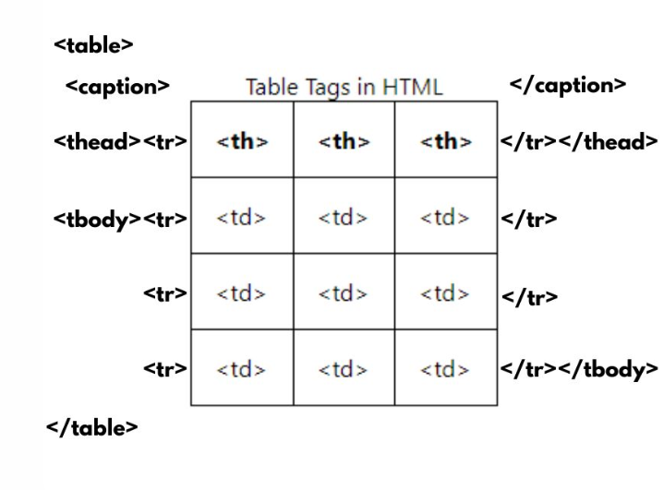

Slide 34
HTMl Table tags
<table> :-Defines the structure for organizing data in rows and columns within a web page.
<tr> :- Represents a row within an HTML table containing individual cells.
<th> :- Shows a table header cell that typically holds titles or headings.
<td> :- Represents a standard data cell, holding content or data.

Slide 35
HTMl Table tags
<caption> :-Provides a title or description for the entire table.
<thead> :- Defines the header section of a table, often containing column labels.
<tbody> :-Represents the main content area of a table, separating it from the header or footer.
<tfoot> :-Specifies the footer section of a table, typically holding summaries or totals.

Slide 36
Attributes of <table> tag
border (deprecated) → sets border width.
cellpadding → space between text and cell border.
cellspacing → space between table cells.
width / height → size of the table.
align (deprecated) → left, center, right.
bgcolor (deprecated) → background color.
bordercolor (deprecated) → color of border.

Slide 37
Attribute of <tr> tag
align (deprecated) → align content inside row (left, center, right).
valign (deprecated) → vertical alignment (top, middle, bottom).
bgcolor (deprecated) → row background color.

Slide 38
Attribute of <th> tag and <td> tag
colspan → span header across multiple columns.
rowspan → span header across multiple rows.
align (deprecated) → left, center, right.
valign (deprecated) → vertical alignment.
bgcolor (deprecated) → background color.
width / height → cell size.

Slide 39
<colgroup> tag
<colgroup> :- The <colgroup> tag is used to group one or more columns in a table so that you can apply common styles or attributes to them at once. It is placed inside a table, before the table rows, and helps in organizing column formatting efficiently.
Key Points :-
Groups columns together.
Can contain one or more <col> tags.
Improves readability and reduces repetition of styles.

Slide 40
<col> tag
The <col> tag is used to define a single column (or multiple columns using span) inside a <colgroup>. You can apply styles like width, background color, or alignment to the entire column without adding the same style to every cell.
Key points:-
Cannot contain content (no <td> or <th> inside).
Styles/attributes applied here affect the whole column.
Can use the span attribute to apply the style to multiple consecutive columns.

Slide 41
Example
<table border="1">
<colgroup bgcolor=red>
<col span="1">
<col span="2">
</colgroup>
<tr> <th>Roll No</th> <th>Name</th> <th>Marks</th> </tr>
<tr> <td>1</td> <td>Aditi</td> <td>90</td> </tr>
</table>

